Slide 1
TEAM NAME CHILL
TEAM MEMBERS
Bhavesh Singh
Harshit singh
Mihir bhatt
SEAT NUMBER C3/a/34 SSOID (Digital identity) PRABHAKAR.141997 REGISTERED MOBILE 8806410509 OTHER CONTACT 7066986066

Slide 2
RIVER(GANGA)REAL TIME MONITORING SYSTEM
IOT BASED

Slide 3
Content
Problem statement
Sensor module
Transmission module
Alarm module
Implementation strategy

Slide 4
Sensor module
The DS18B20 is a temperature sensor is used which has a built in analog-to-digital convertor (ADC). It has 12bit ADC. It can be connected to a raspberry pi’s GPIO pins. It is a 3 pin sensor. Pin 3 acts as power line ( vdd pin 3), pin1 as ground and pin 2 is actual data-output (DQ pin 2) pin. The DQ requires a 4K7 pull-up resistor. It has a temperature range from -55degree Celsius to +125degree Celsius .PHP: hypertext preprocess0or language is used to read data output of DS18B20.

Slide 5
Transmission module
This part consists of data transmission to the server and also to show this data on a web service. Amazon web services AWS EC2, AWS IOT and mongo dB is used for this purpose. To send data from raspberry pi to AWS server backend language Node JS is used. Saying more precisely Socket.io library of Node JS is used. This sensor data is stored on cloud which is mongo dB based backend server known as mongolab (now known as mlab). Mlab is well managed cloud based database service that hosts Mongo DB databases. To retrieve this data from cloud client side socket.io library of nodejs is used. For front end of web service HTML, CSS, JavaScript and for map, google map Application program interface (API) is used. Google map marker are used to show the location of installed sensor module. When the condition at particular position reaches to an alarming level, image of marker is changed from ranger_station.png (green color) to caution.png (red color).

Slide 6
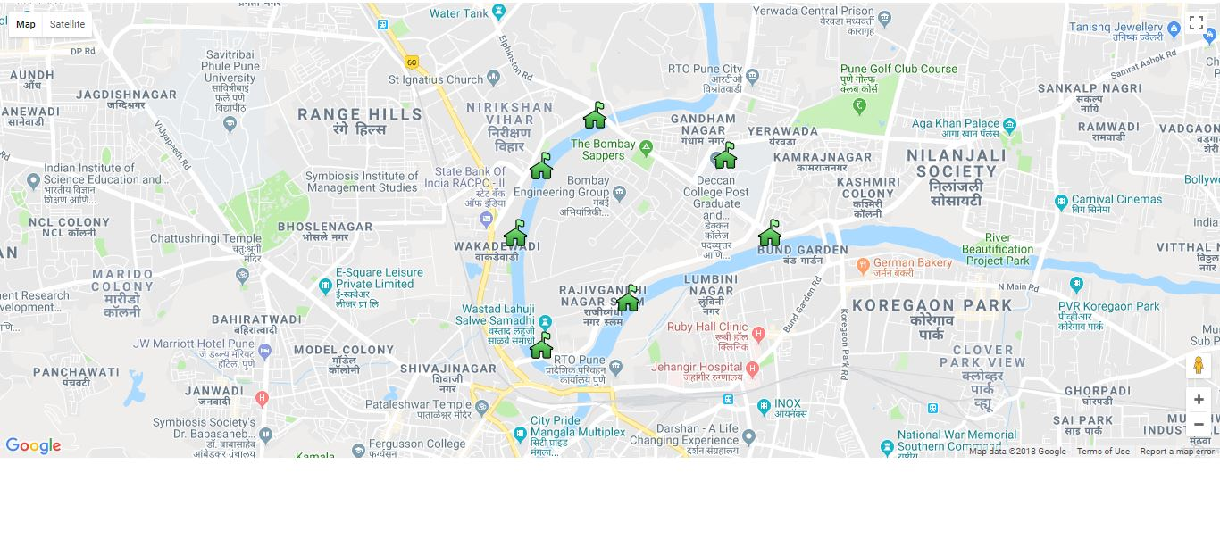
NO ERROR SITUATION WE ARE TAKING AN INSTANCE OF RIVER MUTHA MULA IN PUNE

Slide 7
Alarm module
When the water condition at particular sensor module reaches to an alarming level, an email is sent to the civic authorities. To send email PHP: hypertext preprocessor (PHP) language is used. This email is sent to both local as well as central authorities so that central authorities can direct local authorities to carry out necessary action. The email is sent automatic using functions of JavaScript. Also when any of the node is not working properly (when raspberry pi is switched off) an e-mail is sent to the local authorities.

Slide 8
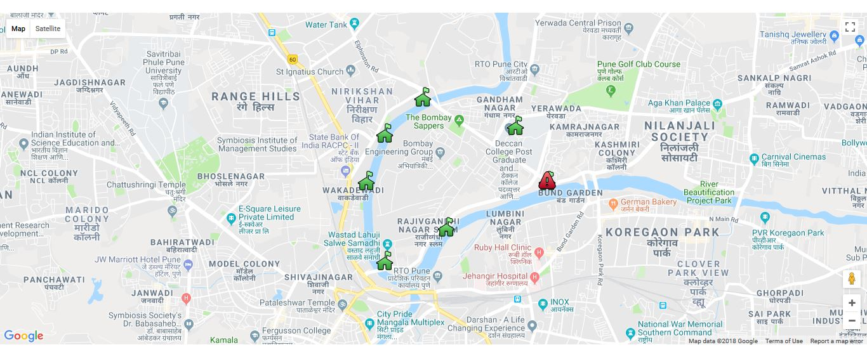
ERROR AT SOME REGION WE ARE TAKING AN INSTANCE OF RIVER MUTHA MULA IN PUNE

Slide 9
Implementation strategy
Our monitoring scenario is divided in four categories viz. area near industries/factories, area near agricultural land and fields, area near canals and area near residential area. Each monitoring area consists of sensor module nodes which will send us data. The number of nodes in particular area can vary depending upon type and amount of pollutants. For example the nodes near residential area will consists of different type of sensor than area near farmland and factories. area near farms have cadmium , arsenic , lead and mercury as prime pollutants therefore these ion sensors will be present in that particular node rather than pH or temperature sensor . Similarly chemical sensor must be present in nodes present near industries as heavy metals like nickel, zinc and molybdenum are present near industries. The water quality changes at different depths. So at monitoring positions nodes are deployed at different depths so than complete and real status can be accessed at every depth of river. Since these sensors nodes have their core controllers in open environment solar panels can be used as power source. Also provision are made to switch power to normal battery when power from solar cell cannot be used or in case of failure of solar cell.

Slide 10
FUTURE SCOPE
For the first phase only temperature sensor is used. In future we can replace the sensing module with desired sensor, also we can add other sensor along with previous one keeping the same architecture.
This proposed system architecture can be used to monitor water quality in dams, reservoirs and can also be implemented in rural areas, which is generally ignored area.
We can also use this for personal use like in house water quality monitoring , checking whether tank water is clean or not, whether it requires cleaning or not ,etc.
It can be used in overhead water tanks.
The data collected from rivers, dams, reservoirs can be used for analysis. It can be published on mygov.in.

